Slide 1

Supervised Learning and Unsupervised Learning
Sukanta Ghosh

Slide 2
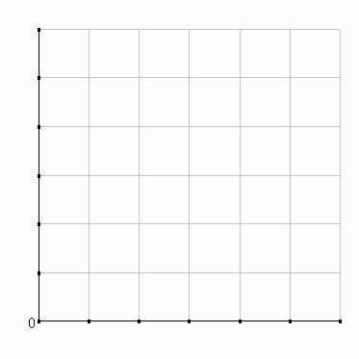
Housing Price Prediction
60
50
X
X
X
40
X
Price (Lac)
X
30
X
X
X
20
X
10
500
1000
1500
2000
2500
3000
Area (Sq. Ft.)
Notes:
Notes:
This is an example of housing price analysis in Semi-urban region.
The data is represented in the form of a graph.
Explain one example of relationship of price and area.

Slide 3
Housing Price Prediction
60
50
X
X
X
40
X
Price (Lac)
X
30
X
X
X
20
X
10
500
1000
1500
2000
2500
3000
1300
Area (Sq. Ft.)
Notes:
Notes:
Suppose your friend want to purchase/sell a house with 750 sq. ft. area. How we will predict the price of the house.
Here, learning is prediction of price of the house with given data.

Slide 4
Housing Price Prediction
60
50
X
X
X
40
X
Price (Lac)
X
30
X
X
X
20
X
10
500
1000
1500
2000
2500
3000
1300
Area (Sq. Ft.)
Notes:
Notes:
1. We can fit a straight line through the given data and try to accommodate all given possible points. Then we can calculate the estimate price of the house.

Slide 5
Housing Price Prediction
60
50
X
X
X
40
X
Price (Lac)
X
30
X
X
X
20
X
10
500
1000
1500
2000
2500
3000
1300
Area (Sq. Ft.)
Notes:
Notes:
Straight line is not the only solution.
Instead of fitting a straight line to the data, we might decide that it is better to fit a quadratic function, or second order polynomial into the data.
Later on we will see weather we want to fit a straight line or quadratic function or something else.

Slide 6
Housing Price Prediction
60
50
X
X
X
40
X
Price (Lac)
X
30
X
X
X
20
X
10
500
1000
1500
2000
2500
3000
1300
Area (Sq. Ft.)
Notes:
Notes:
This is example of supervised learning algorithm.
The term Supervised Learning refers to the fact that we gave the algorithm a data set in which the, called, "right answers" were given.
We gave it a data set of houses in which for every example in this data set, we told it what is the right price.
This is a problem of “Regression”, predict a continuous valued output.

Slide 7
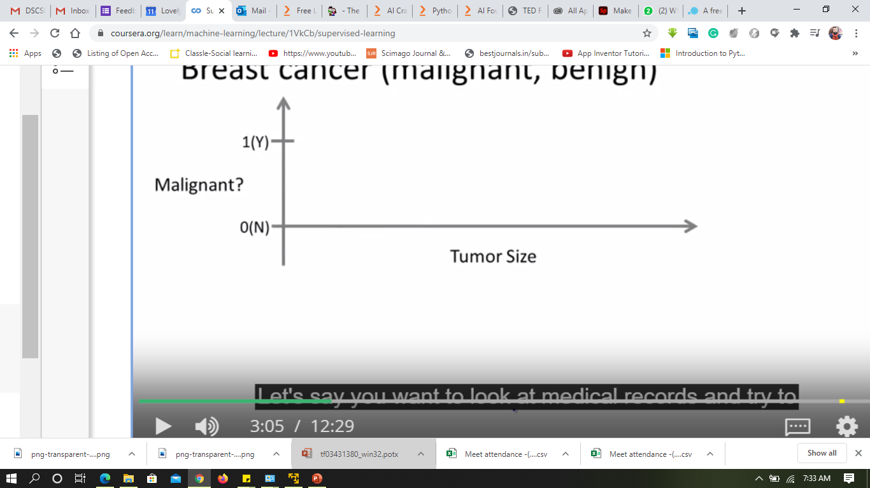
Breast Cancer (malignant, benign)
O
O
O
O
O
X
X
X
X
X

Slide 8
Breast Cancer (malignant, benign)
X
X
X
X
X
X
X
X
X
X

Slide 9
Breast Cancer (malignant, benign)
X
X
X
X
X
X
X
X
X
X
X
X
X
X
X
O
O
O
O
O

Slide 10
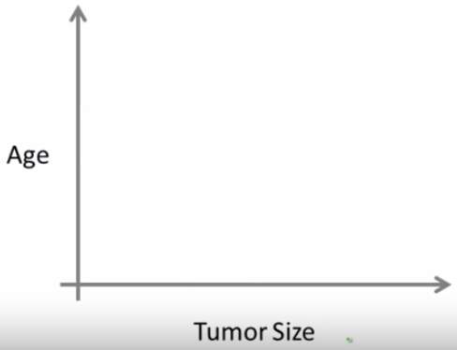
Breast Cancer (malignant, benign)
X
X
X
X
O
X
X
X
O
O
O
O
X
O
O
O
O

Slide 11
Breast Cancer (malignant, benign)
X
X
Other Factors:
Clump Thickness
Uniformity of cell size
Uniformity of cell shape etc.
X
X
O
X
X
O
X
O
O
O
O
X
O
O
O
O

Slide 12
Supervised Learning: Recap
In supervised learning, we are given a data set and already know what our correct output should look like, having the idea that there is a relationship between the input and the output.
Supervised learning problems are categorized into "regression" and "classification" problems.
In a regression problem, we are trying to predict results within a continuous output, meaning that we are trying to map input variables to some continuous function.
In a classification problem, we are instead trying to predict results in a discrete output. In other words, we are trying to map input variables into discrete categories.

Slide 13
Lets Practice
Problem set 1: You have a large inventory of identical items. So, imagine that you have thousands of copies of some identical items to sell, and you want to predict how many of these items you sell over the next three months.
Problem set 2: You have lots of users, and you want to write software to examine each individual of your customer's accounts, to check weather someone's account is hacked or not.
Problem set 3: Given a picture of a person, we have to predict their age on the basis of the given picture
Problem set 4: Given a patient with a tumor, we have to predict whether the tumor is malignant or benign.

Slide 14
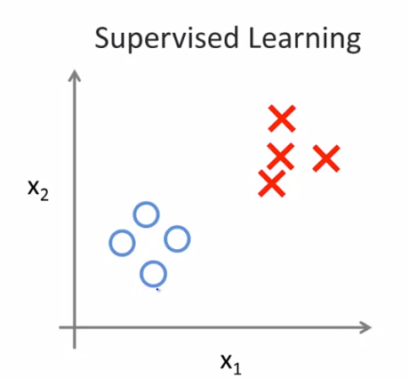
Unsupervised Machine Learning
Notes:
Concept of labels need to be explained

Slide 15
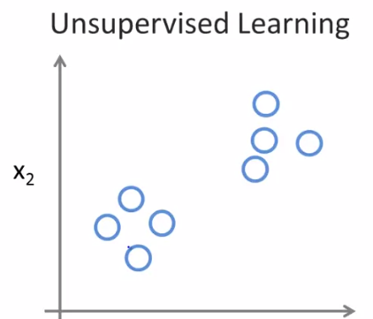
Unsupervised Machine Learning
Notes:
No labels are given or same labels are given.
Example of google news to be shared

Slide 16

Google News

Slide 17
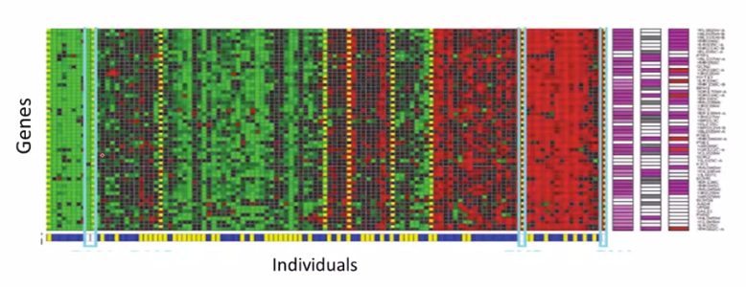
Human Genes Types

Slide 18
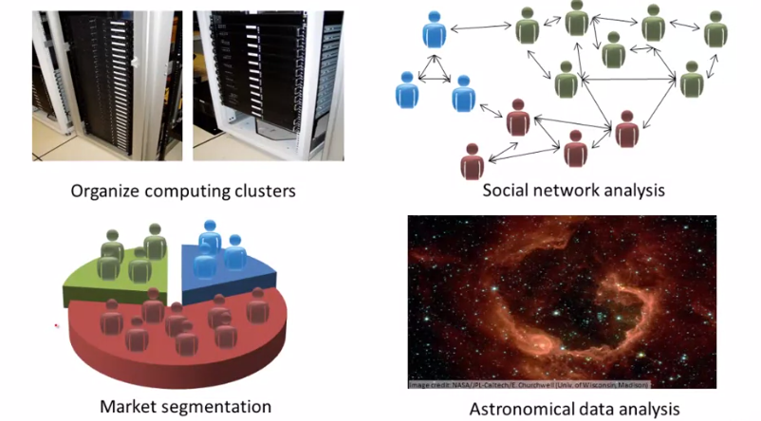
Other Examples

Slide 19
Unsupervised Learning
Unsupervised learning allows us to approach problems with little or no idea what our results should look like.
We can derive structure from data where we don't necessarily know the effect of the variables.
We can derive this structure by clustering the data based on relationships among the variables in the data.
With unsupervised learning there is no feedback based on the prediction results.
Clustering: Take a collection of 1,000,000 different genes, and find a way to automatically group these genes into groups that are somehow similar or related by different variables, such as lifespan, location, roles, and so on.

